Slide 1

Visual Analyses of Meta-Kaggle Data to Uncover Trends in the Data Science Landscape
ENGR-E583: Client Project
Yeon-Soo Chung (Team Leader)
Kabir Chaturvedi
Bhoomika Pathapati
Monisha Patro
Ishika Thakur

Slide 2
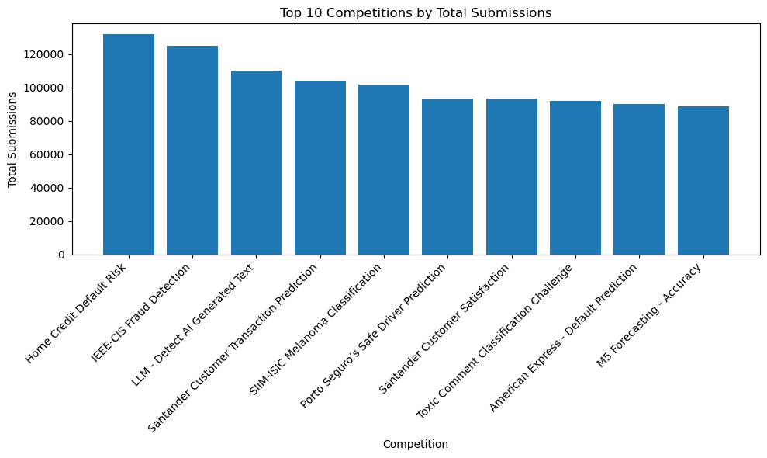
Most Popular Competitions
These quantities are submissions made to competitions during their open dates (before deadlines).
Number of submissions will depend on factors such as when competition occurred, prize money, level of difficulty, and submission limits.
How do these numbers vary over time?

Slide 3
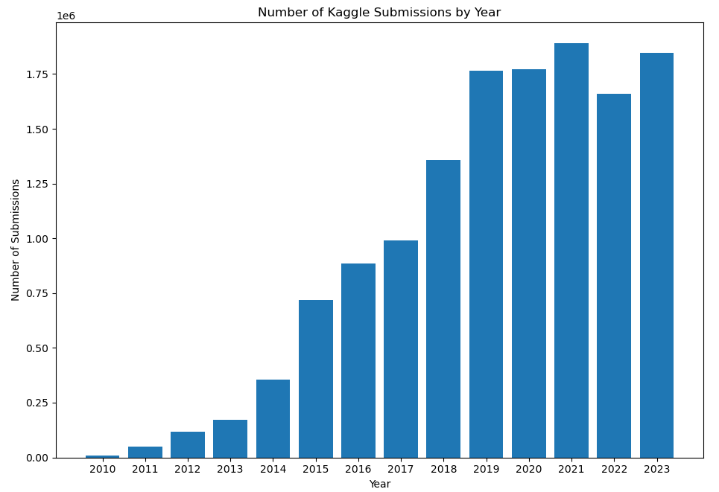
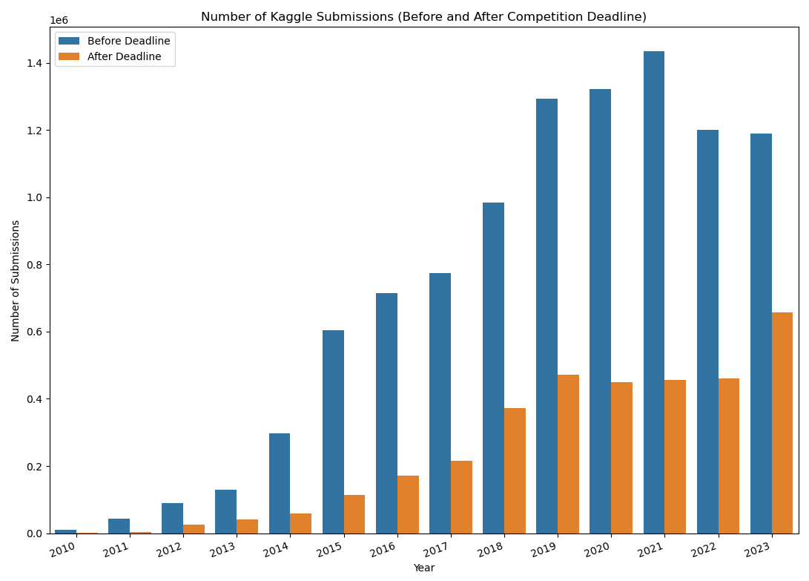
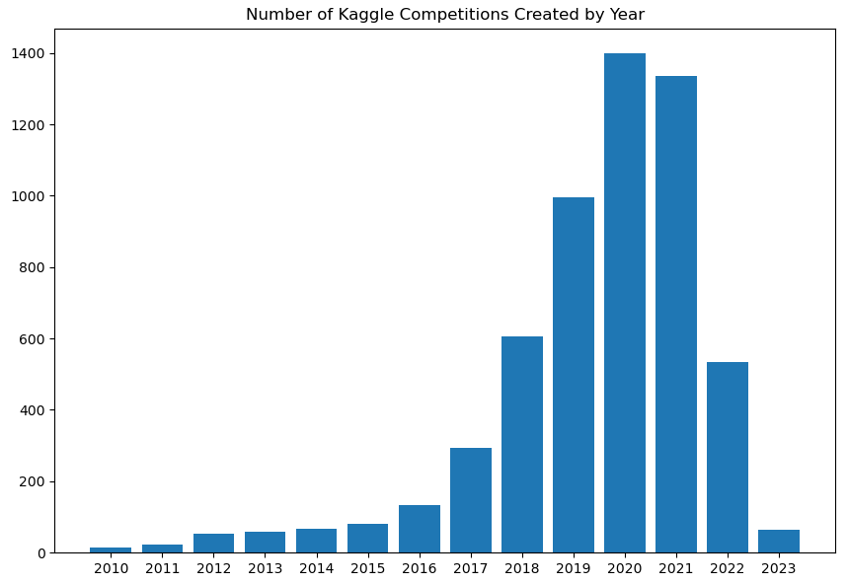
Competition Submissions by Year and by Pre/Post-Deadline
Break down by pre and post-deadline
Top left and top right: Submission quantities are broken down into pre- and post-deadline submission. Small decrease in pre-deadline submissions is offset by small increase in post-deadline submissions, resulting in plateau of overall submissions since 2019.
Lower plot: the number of new competitions created each year. There is a sharp decrease since 2021, but the trends in the upper plots do not decrease accordingly. This suggests an explosion of interest in Kaggle and data science in recent years.

Slide 4
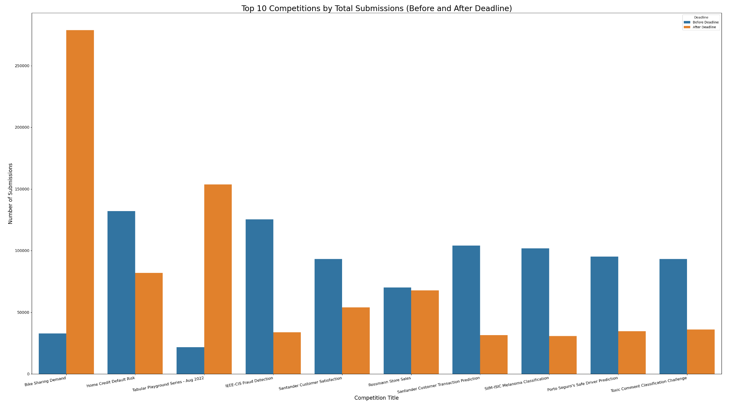
Top 10 Competitions
Competitions with high post-deadline submissions indicate their pedagogical or learning values.
There are only two competitions with more post-deadline submissions, but the imbalance is much greater than competitions with more pre-deadline submissions, which there are more of.

Slide 5
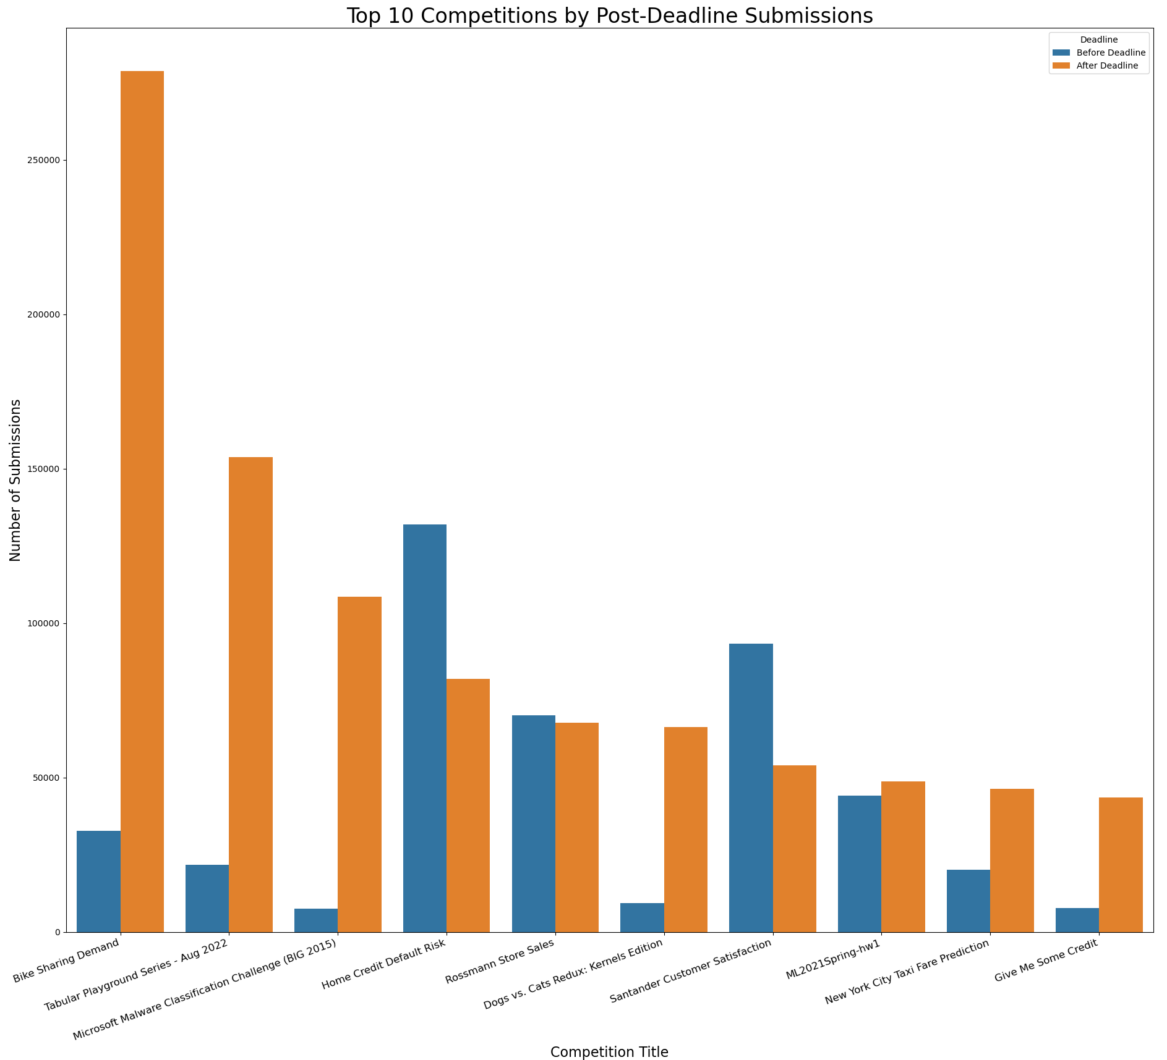
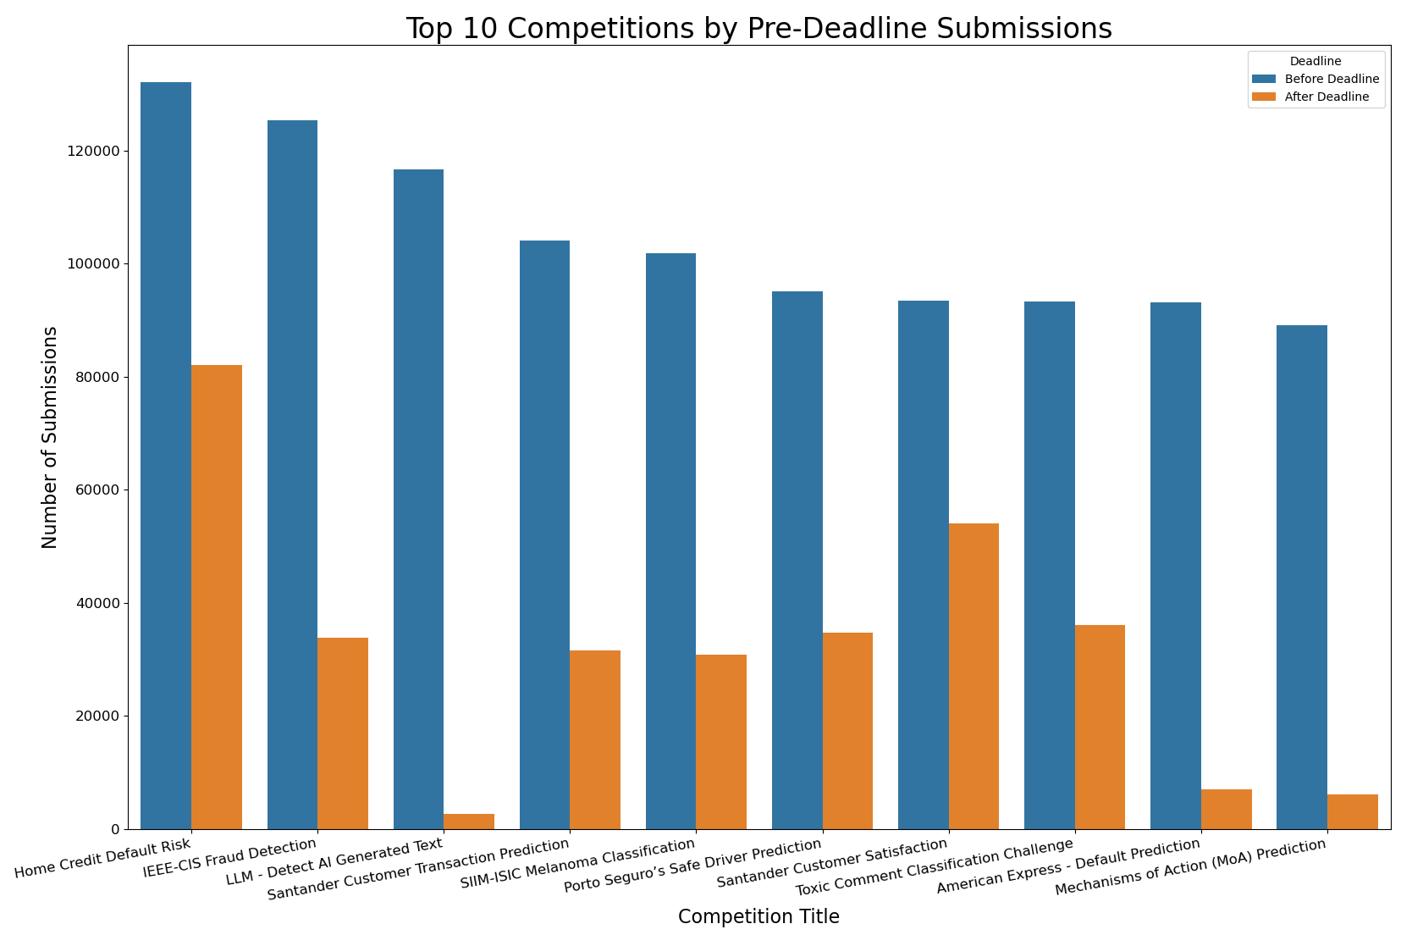
Top 10 Competitions
There are only two competitions that are in both plots below. A popular competition pre-deadline does not translate to higher post-deadline submissions.

Slide 6
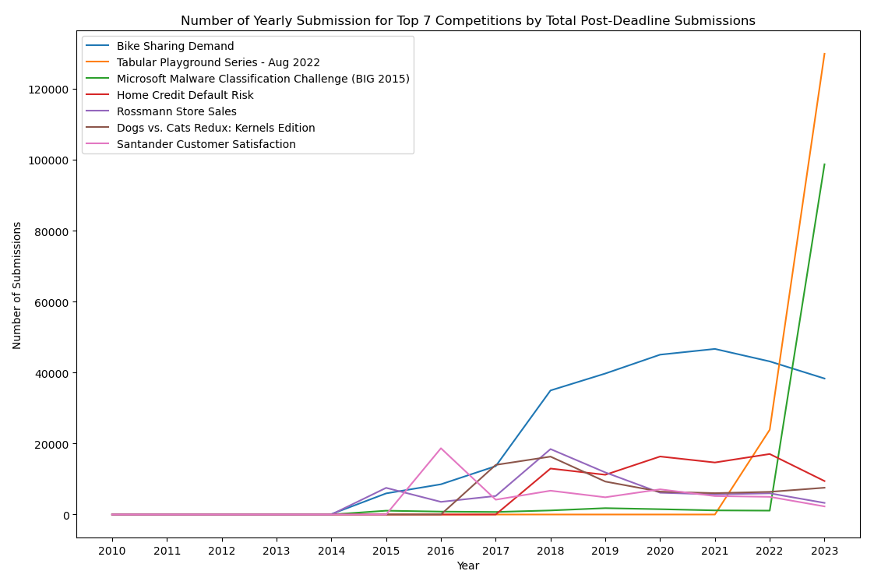
Year-by-Year Breakdown of Top 7 Competitions
This line graph plots the yearly post-deadline submissions of the seven competitions with the highest total post-deadline submissions.
The bike sharing competition was the most popular from 2018-2022 before being overtaken by the skyrocketing popularities of the tabular playground series (Aug 2022) and Microsoft malware competitions.

Slide 7
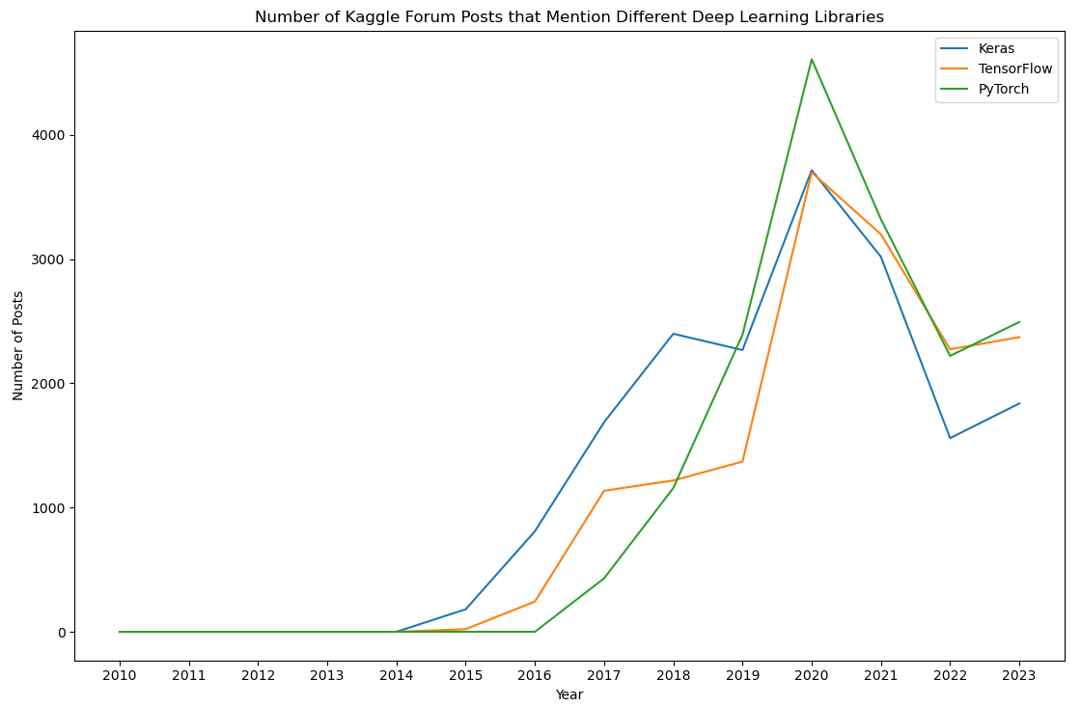
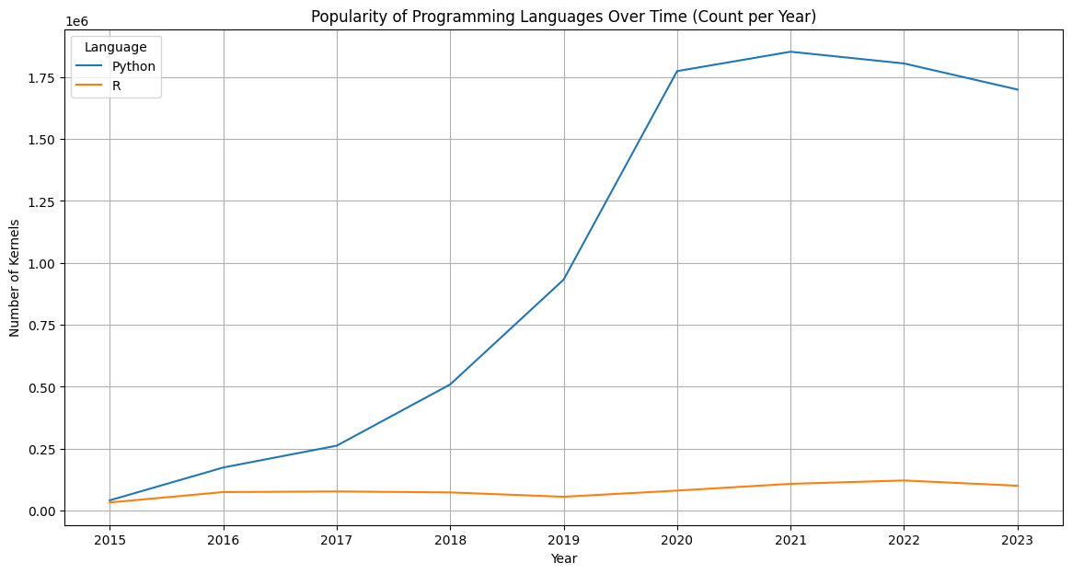
Popularity of Languages and Deep Learning Libraries
R’s popularity among kernels remains consistent over the years, while Python has become far more popular.
Among the three most commonly used deep learning frameworks, PyTorch, the most recently developed, was mentioned more than the other two in Kaggle forum posts in 2019-2021. Nowadays, it seems PyTorch and TensorFlow are in a dead heat for most widely used framework.

